Slide 1
STATE OF THE NATION
What's happening in Australia and what it means
for property owners and investors
by George Markoski
Notes:
State of the Nation: four updates from the latest available releases, outside this week's rate decision. Each slide gives its release date.

Slide 2
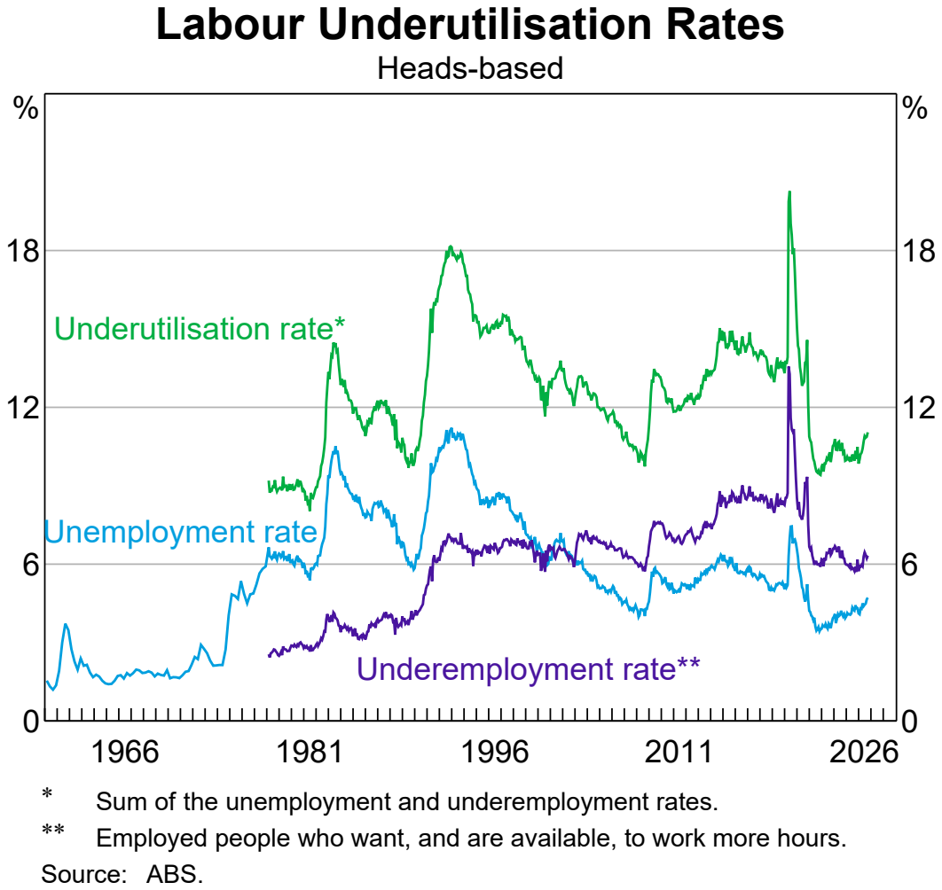
Unemployment
Is Creeping Up
The unemployment rate rose to 4.7% in September.
732,000 people are now unemployed.
The RBA expects it to reach 5.1% by the end of 2028.
Source: Australian Bureau of Statistics, Labour Force, Australia, September 2026 (released 15 October 2026), seasonally adjusted; Reserve Bank of Australia, Statement on Monetary Policy, November 2026; chart: RBA Chart Pack, November 2026 (data: ABS).
Notes:
The labour market is still strong by history, but it is turning. Ask George: what does a softer jobs market mean for tenants and borrowers?
Register: R01, R02, R03
Sources:
S6 Australian Bureau of Statistics, Labour Force, Australia, September 2026, 2026-10-15: https://www.abs.gov.au/statistics/labour/employment-and-unemployment/labour-force-australia/latest-release
S4 Reserve Bank of Australia, Statement on Monetary Policy – November 2026, 2026-11-03: https://www.rba.gov.au/publications/smp/2026/nov/
S3 Reserve Bank of Australia, Chart Pack, November 2026, 2026-11-04: https://www.rba.gov.au/chart-pack/pdf/chart-pack.pdf

Slide 3
Australia Keeps Growing
392,700
1.4%
292,100
people added to the population in the year to March 2026
annual population growth
net overseas migration, year to March 2026
Natural increase (births minus deaths) added 100,600.
Source: Australian Bureau of Statistics, National, state and territory population, March 2026 (released 17 September 2026).
Notes:
The latest population figures are for the March quarter; the June quarter release is due in December.
Register: R04, R05, R06, R07
Sources:
S8 Australian Bureau of Statistics, National, state and territory population, March 2026, 2026-09-17: https://www.abs.gov.au/statistics/people/population/national-state-and-territory-population/latest-release

Slide 4
Apartment Approvals
Jumped in September
BUILDING APPROVALS
17,948
16.6%
dwellings approved in September, up 5.1% on August
rise in approvals for private apartments
and other non-house dwellings
5.3%
fall in private house approvals
Source: Australian Bureau of Statistics, Building Approvals, Australia, September 2026 (released 2 November 2026), seasonally adjusted.
Notes:
Monthly approvals are volatile, especially apartments. One month is a signal to watch, not a trend.
Register: R08, R09, R10, R11
Sources:
S7 Australian Bureau of Statistics, Building Approvals, Australia, September 2026, 2026-11-02: https://www.abs.gov.au/statistics/industry/building-and-construction/building-approvals-australia/latest-release

Slide 5
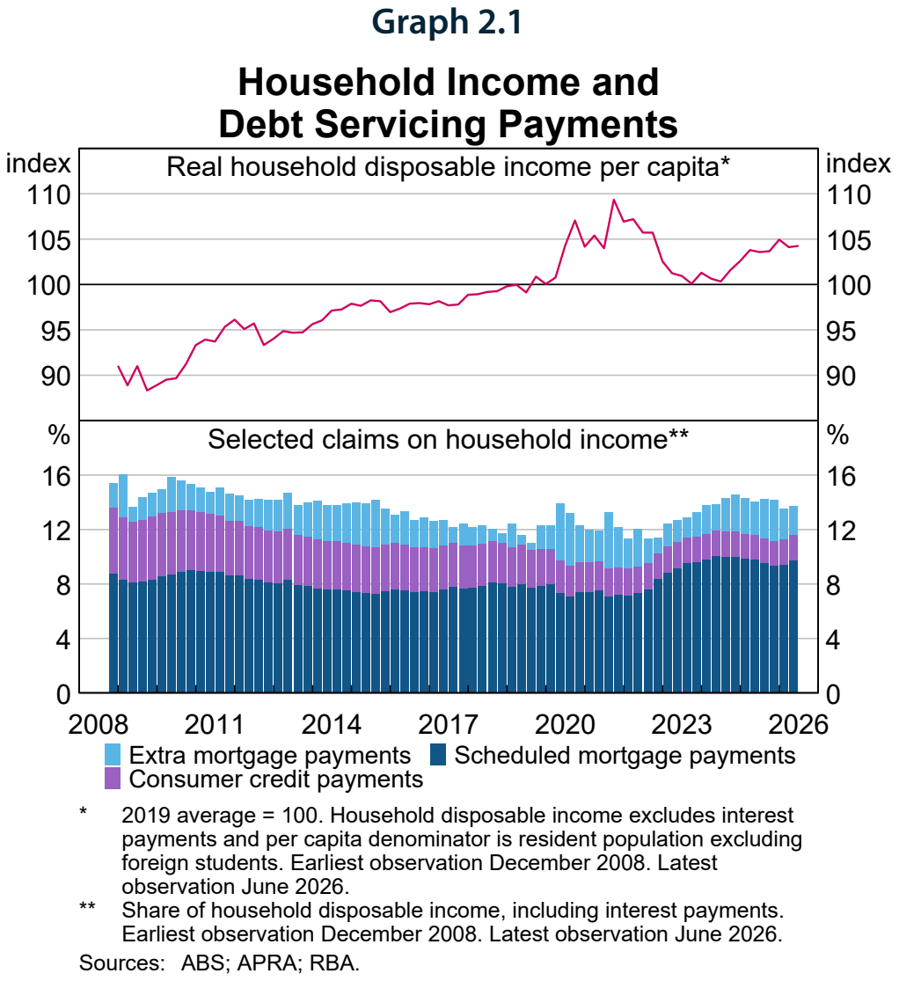
Real Incomes
Have Slipped
Real household disposable income per person declined slightly over the first half of 2026.
It is still higher on average than in 2023 and 2024.
Source: Reserve Bank of Australia, Financial Stability Review, October 2026, Graph 2.1 (data: ABS, APRA, RBA; latest observation June 2026).
Notes:
Per capita and after inflation. Cost pressures have hit lower-income households hardest.
Sources:
S5 Reserve Bank of Australia, Financial Stability Review – October 2026, 2026-10-01: https://www.rba.gov.au/publications/fsr/2026/oct/

Slide 6
Rates Are Rising
Again. Is Your
Portfolio Ready?
Inflation is high, house prices are falling, new home loans are down.
Here's what the data says for investors.
Notes:
Main topic. The RBA raised rates on Tuesday; tonight we look at what is driving it and what it means for property.

Slide 7
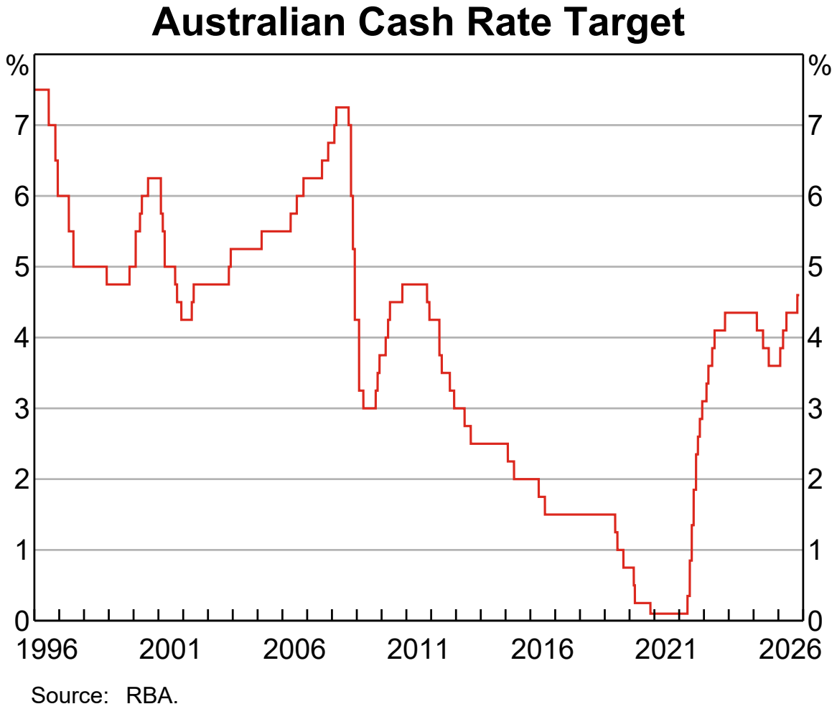
The RBA Has
Raised Rates
Again
The cash rate rose 25 basis points to 4.85% on 3 November.
Six board members voted to raise; three wanted to hold.
Source: Reserve Bank of Australia, Monetary Policy Decision, 3 November 2026; chart: RBA Chart Pack, 4 November 2026, data to 29 October (before this rise).
Notes:
The chart ends before this week's rise. A split board: what does it tell us about the next move?
Register: R12, R13, R14, R15
Sources:
S1 Reserve Bank of Australia, Statement by the Monetary Policy Board: Monetary Policy Decision, 2026-11-03: https://www.rba.gov.au/media-releases/2026/mr-26-30.html
S3 Reserve Bank of Australia, Chart Pack, November 2026, 2026-11-04: https://www.rba.gov.au/chart-pack/pdf/chart-pack.pdf

Slide 8
Why the RBA Moved
The pressures behind this week's decision
01 | Fuel prices
02 | Tight capacity
The Middle East conflict has pushed up fuel and other commodity prices.
Domestic capacity pressures were a little tighter than earlier thought.
03 | AI boom
04 | Expectations
AI-related investment is driving rapid price growth for technology goods.
Some measures of inflation expectations have risen lately.
Source: Reserve Bank of Australia, Statement by the Monetary Policy Board: Monetary Policy Decision, 3 November 2026.
Notes:
All four come straight from the Board's statement. Which of these can an investor actually plan around?

Slide 9
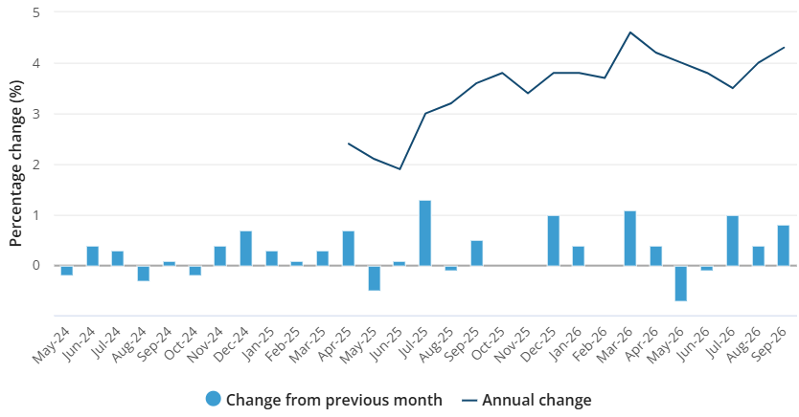
Inflation Is Moving the Wrong Way
4.3%
annual inflation to September, up from 4.0% in August
3.6%
trimmed mean inflation, up from 3.5%
Source: Australian Bureau of Statistics, “All groups CPI, Australia, monthly and annual movement (%)”, Consumer Price Index, Australia, September 2026 (released 28 October 2026).
Notes:
Monthly CPI, original terms. Trimmed mean is a measure of underlying inflation.
Register: R16, R17, R18, R19
Sources:
S2 Australian Bureau of Statistics, Consumer Price Index, Australia, September 2026, 2026-10-28: https://www.abs.gov.au/statistics/economy/price-indexes-and-inflation/consumer-price-index-australia/latest-release

Slide 10
Where Prices Are Rising Fastest
8.7%
5.2%
4.7%
transport, annual rise to September
housing costs, annual rise to September
education, annual rise to September
Each is rising faster than overall inflation of 4.3%.
Source: Australian Bureau of Statistics, Consumer Price Index, Australia, September 2026 (CPI groups, year to September 2026).
Notes:
Register: R20, R21, R22, R23
Sources:
S2 Australian Bureau of Statistics, Consumer Price Index, Australia, September 2026, 2026-10-28: https://www.abs.gov.au/statistics/economy/price-indexes-and-inflation/consumer-price-index-australia/latest-release

Slide 11
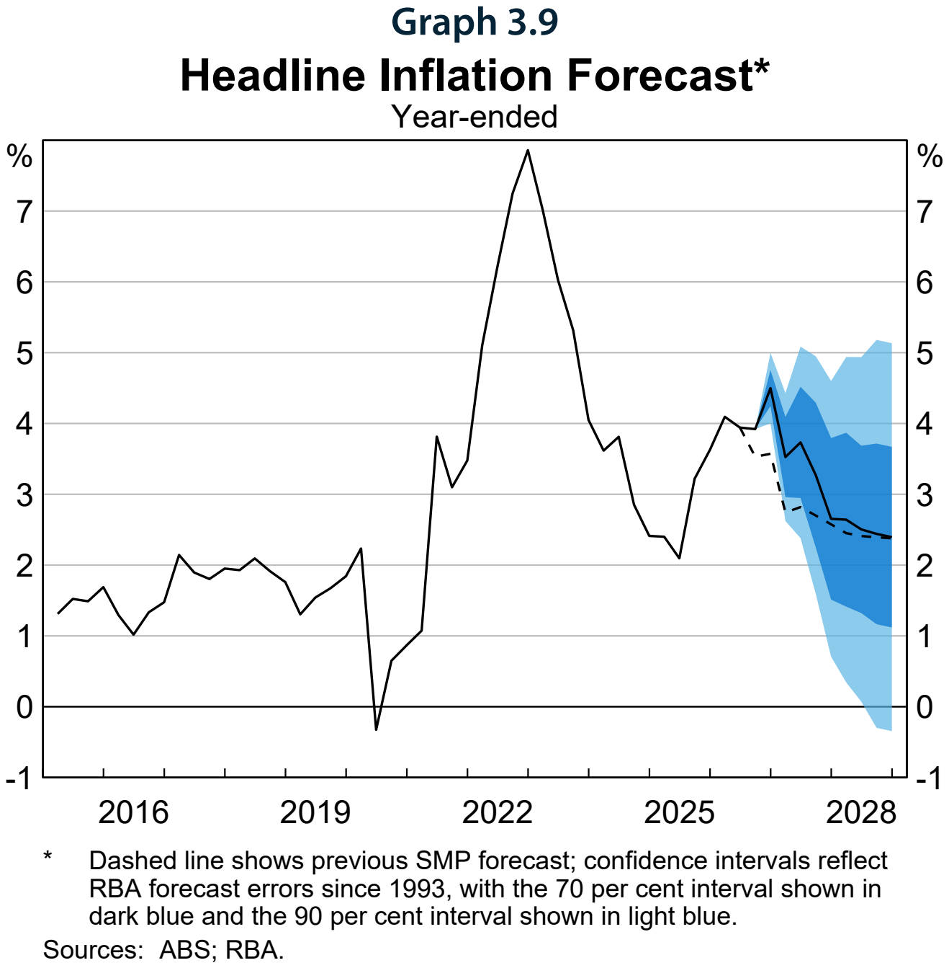
Inflation Is
Expected to Stay
High for Longer
4.5%
forecast peak in headline inflation, December quarter 2026
Source: Reserve Bank of Australia, Statement on Monetary Policy, November 2026, Graph 3.9 Headline Inflation Forecast (data: ABS, RBA).
Notes:
A forecast, not a fact: the shaded bands show how uncertain it is. Inflation is not expected back at the middle of the target until mid-2028.
Register: R24
Sources:
S4 Reserve Bank of Australia, Statement on Monetary Policy – November 2026, 2026-11-03: https://www.rba.gov.au/publications/smp/2026/nov/

Slide 12
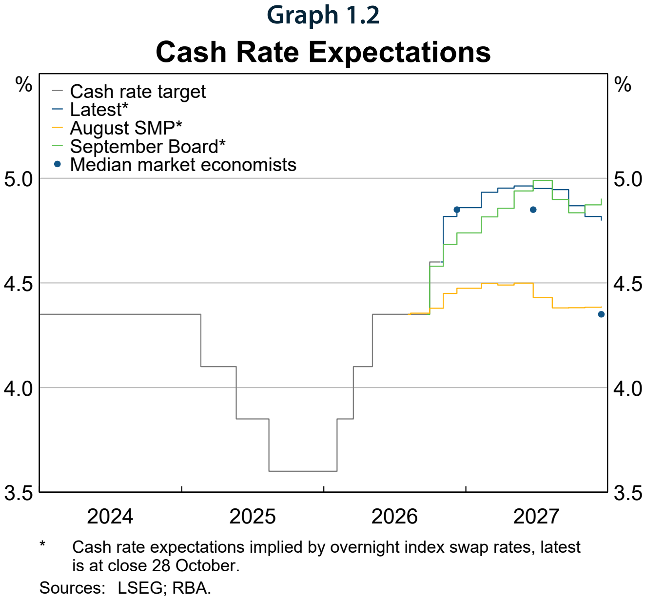
The RBA Assumes
Rates Stay High
4.8%
cash rate the RBA's forecasts assume for 2028, from market pricing at 28 October; the chart runs to the end of 2027
Source: Reserve Bank of Australia, Statement on Monetary Policy, November 2026: 4.8% from chapter 3 (Outlook); chart: Graph 1.2 Cash Rate Expectations (data: LSEG, RBA; market pricing at close 28 October, before the 3 November decision).
Notes:
The market path rises a little further into 2027, then settles. Markets can be wrong in both directions.
Register: R25
Sources:
S4 Reserve Bank of Australia, Statement on Monetary Policy – November 2026, 2026-11-03: https://www.rba.gov.au/publications/smp/2026/nov/

Slide 13
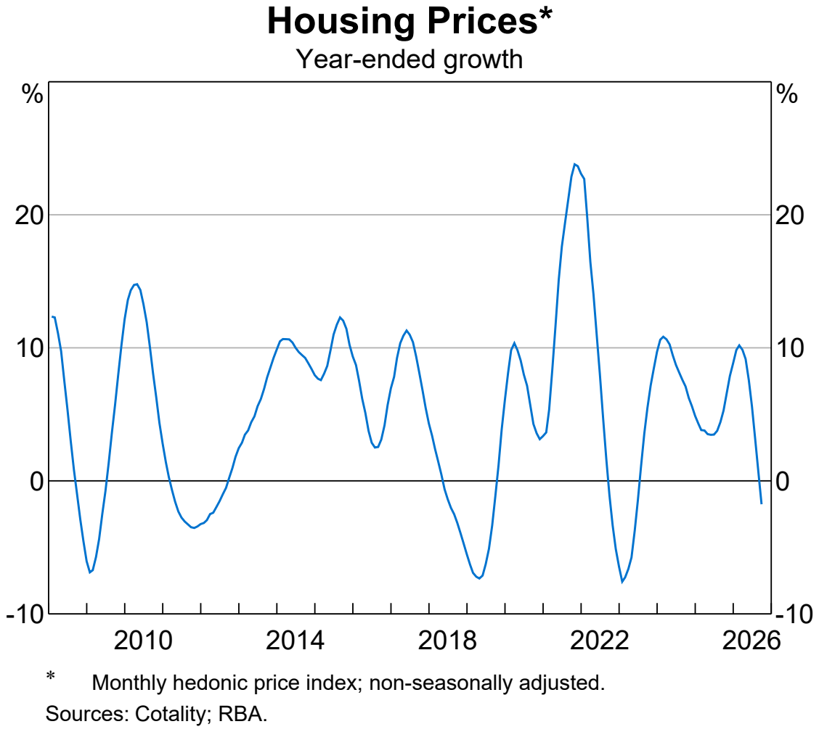
Prices Have Already
Turned Down
In September, national housing prices were 4.7% below their recent peak.
The RBA calls it one of the steepest downturns of the past 50 years.
The chart shows annual growth, which has turned negative.
Source: Reserve Bank of Australia, Statement on Monetary Policy, November 2026 (fall from peak and the 50-year comparison); chart: RBA Chart Pack, November 2026, Housing Prices, year-ended growth (data: Cotality, RBA; data to 29 October).
Notes:
Year-ended growth in the national hedonic index has turned negative. Declines have broadened to most capital cities.
Register: R26, R27
Sources:
S4 Reserve Bank of Australia, Statement on Monetary Policy – November 2026, 2026-11-03: https://www.rba.gov.au/publications/smp/2026/nov/
S3 Reserve Bank of Australia, Chart Pack, November 2026, 2026-11-04: https://www.rba.gov.au/chart-pack/pdf/chart-pack.pdf

Slide 14
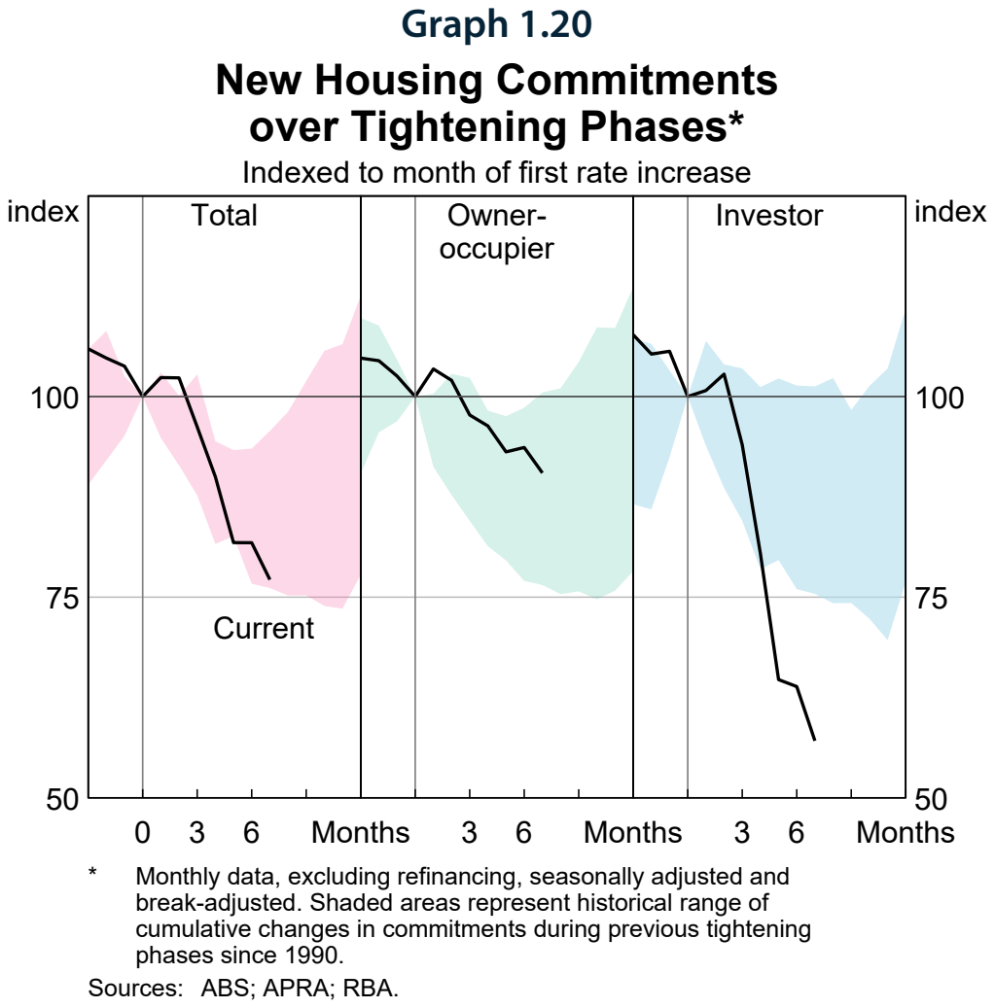
Investors Have
Pulled Back
the Most
27%
fall in total new housing loan commitments since their November 2025 peak; investor lending fell more sharply
Source: Reserve Bank of Australia, Statement on Monetary Policy, November 2026; chart: Graph 1.20 New Housing Commitments over Tightening Phases, indexed to the month of the first rate rise, not the peak (data: ABS, APRA, RBA).
Notes:
Each panel is indexed to the month of the first rate rise in that tightening phase. The fall in new lending has been sharpest for investors, mostly loans to buy established homes.
Register: R28
Sources:
S4 Reserve Bank of Australia, Statement on Monetary Policy – November 2026, 2026-11-03: https://www.rba.gov.au/publications/smp/2026/nov/

Slide 15
Most Borrowers Are Holding Up
Most borrowers have positive equity, and most households with mortgages have built up large savings buffers.
So how much stress is out there?
Source: Reserve Bank of Australia, Financial Stability Review, October 2026.

Slide 16
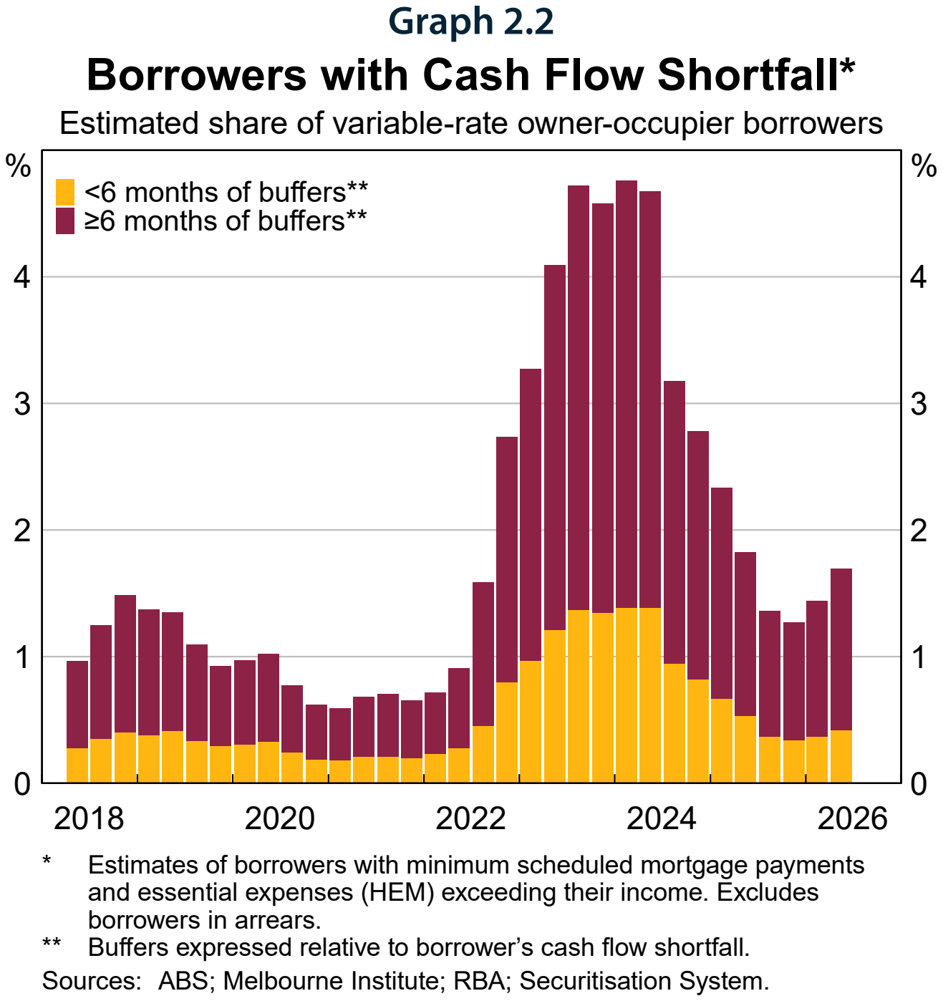
Measured Stress
Was Still Low
2%
of variable-rate owner-occupiers had an estimated cash flow shortfall (around, first half of 2026; excludes borrowers in arrears)
Source: Reserve Bank of Australia, Financial Stability Review, October 2026, Graph 2.2 Borrowers with Cash Flow Shortfall (data: ABS, Melbourne Institute, RBA, Securitisation System).
Notes:
A cash flow shortfall means income doesn't cover scheduled repayments plus essential expenses. It rose a little this year but is well below its earlier peak.
Register: R30
Sources:
S5 Reserve Bank of Australia, Financial Stability Review – October 2026, 2026-10-01: https://www.rba.gov.au/publications/fsr/2026/oct/

Slide 17
The Buffers Are Big
WHAT BORROWERS HOLD
Under 1%
Over a year
of borrowers estimated to owe more than their property is worth
of scheduled repayments the median borrower
holds in offset and redraw (at October rates)
5%
of mortgages could go into negative equity if prices fell 20% (scenario)
Source: Reserve Bank of Australia, Financial Stability Review, October 2026 (RBA Securitisation System data; scenario: a uniform fall from the FSR's valuation base, all else equal).
Notes:
The 20% fall is an RBA stress scenario, not a forecast. Negative equity alone rarely causes default if the borrower can still pay.
Register: R31, R32, R33, R42
Sources:
S5 Reserve Bank of Australia, Financial Stability Review – October 2026, 2026-10-01: https://www.rba.gov.au/publications/fsr/2026/oct/

Slide 18
Where Things Could Go
RBA CENTRAL FORECAST
RBA 'VERY ADVERSE' STRESS TEST
5.1%
6.3%
unemployment rate forecast by end-2028 (November forecast)
unemployment rate, with inflation at 7% (illustrative shock)
5.6%
cash rate in the same shock
Inflation expected back to the middle of the target range by mid-2028.
Mortgagors at higher risk of default could rise to around 5%.
Source: Reserve Bank of Australia, Statement on Monetary Policy, November 2026 (central forecast); Financial Stability Review, October 2026 (illustrative joint shock, not a forecast and with no set date).
Notes:
Left: the RBA's November forecast. Right: an illustrative stress test from the October FSR, where unemployment, inflation and the cash rate all jump together. It is not an alternative forecast and has no set date, so don't compare the two sides year for year.
Register: R34, R35, R36, R37, R38, R43
Sources:
S4 Reserve Bank of Australia, Statement on Monetary Policy – November 2026, 2026-11-03: https://www.rba.gov.au/publications/smp/2026/nov/
S5 Reserve Bank of Australia, Financial Stability Review – October 2026, 2026-10-01: https://www.rba.gov.au/publications/fsr/2026/oct/

Slide 19
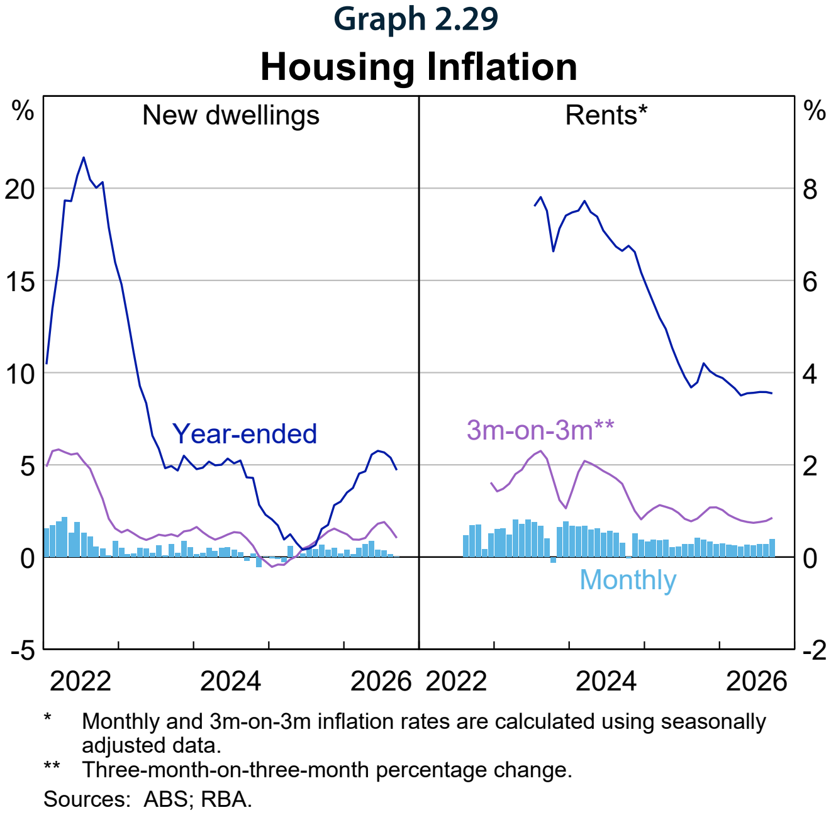
Rents Are Still
Rising
CPI rents rose 0.9% in the September quarter.
They are up 3.6% over the year.
Vacancy rates have edged up and advertised rent growth has slowed.
Source: Reserve Bank of Australia, Statement on Monetary Policy, November 2026, Graph 2.29 Housing Inflation (data: ABS, RBA).
Notes:
The RBA says this may be early evidence that earlier rises in advertised rents are passing through to CPI rents.
Register: R39, R40
Sources:
S4 Reserve Bank of Australia, Statement on Monetary Policy – November 2026, 2026-11-03: https://www.rba.gov.au/publications/smp/2026/nov/

Slide 20
WHAT IT MEANS FOR INVESTORS
Cutting through the noise to find the signal

Slide 21
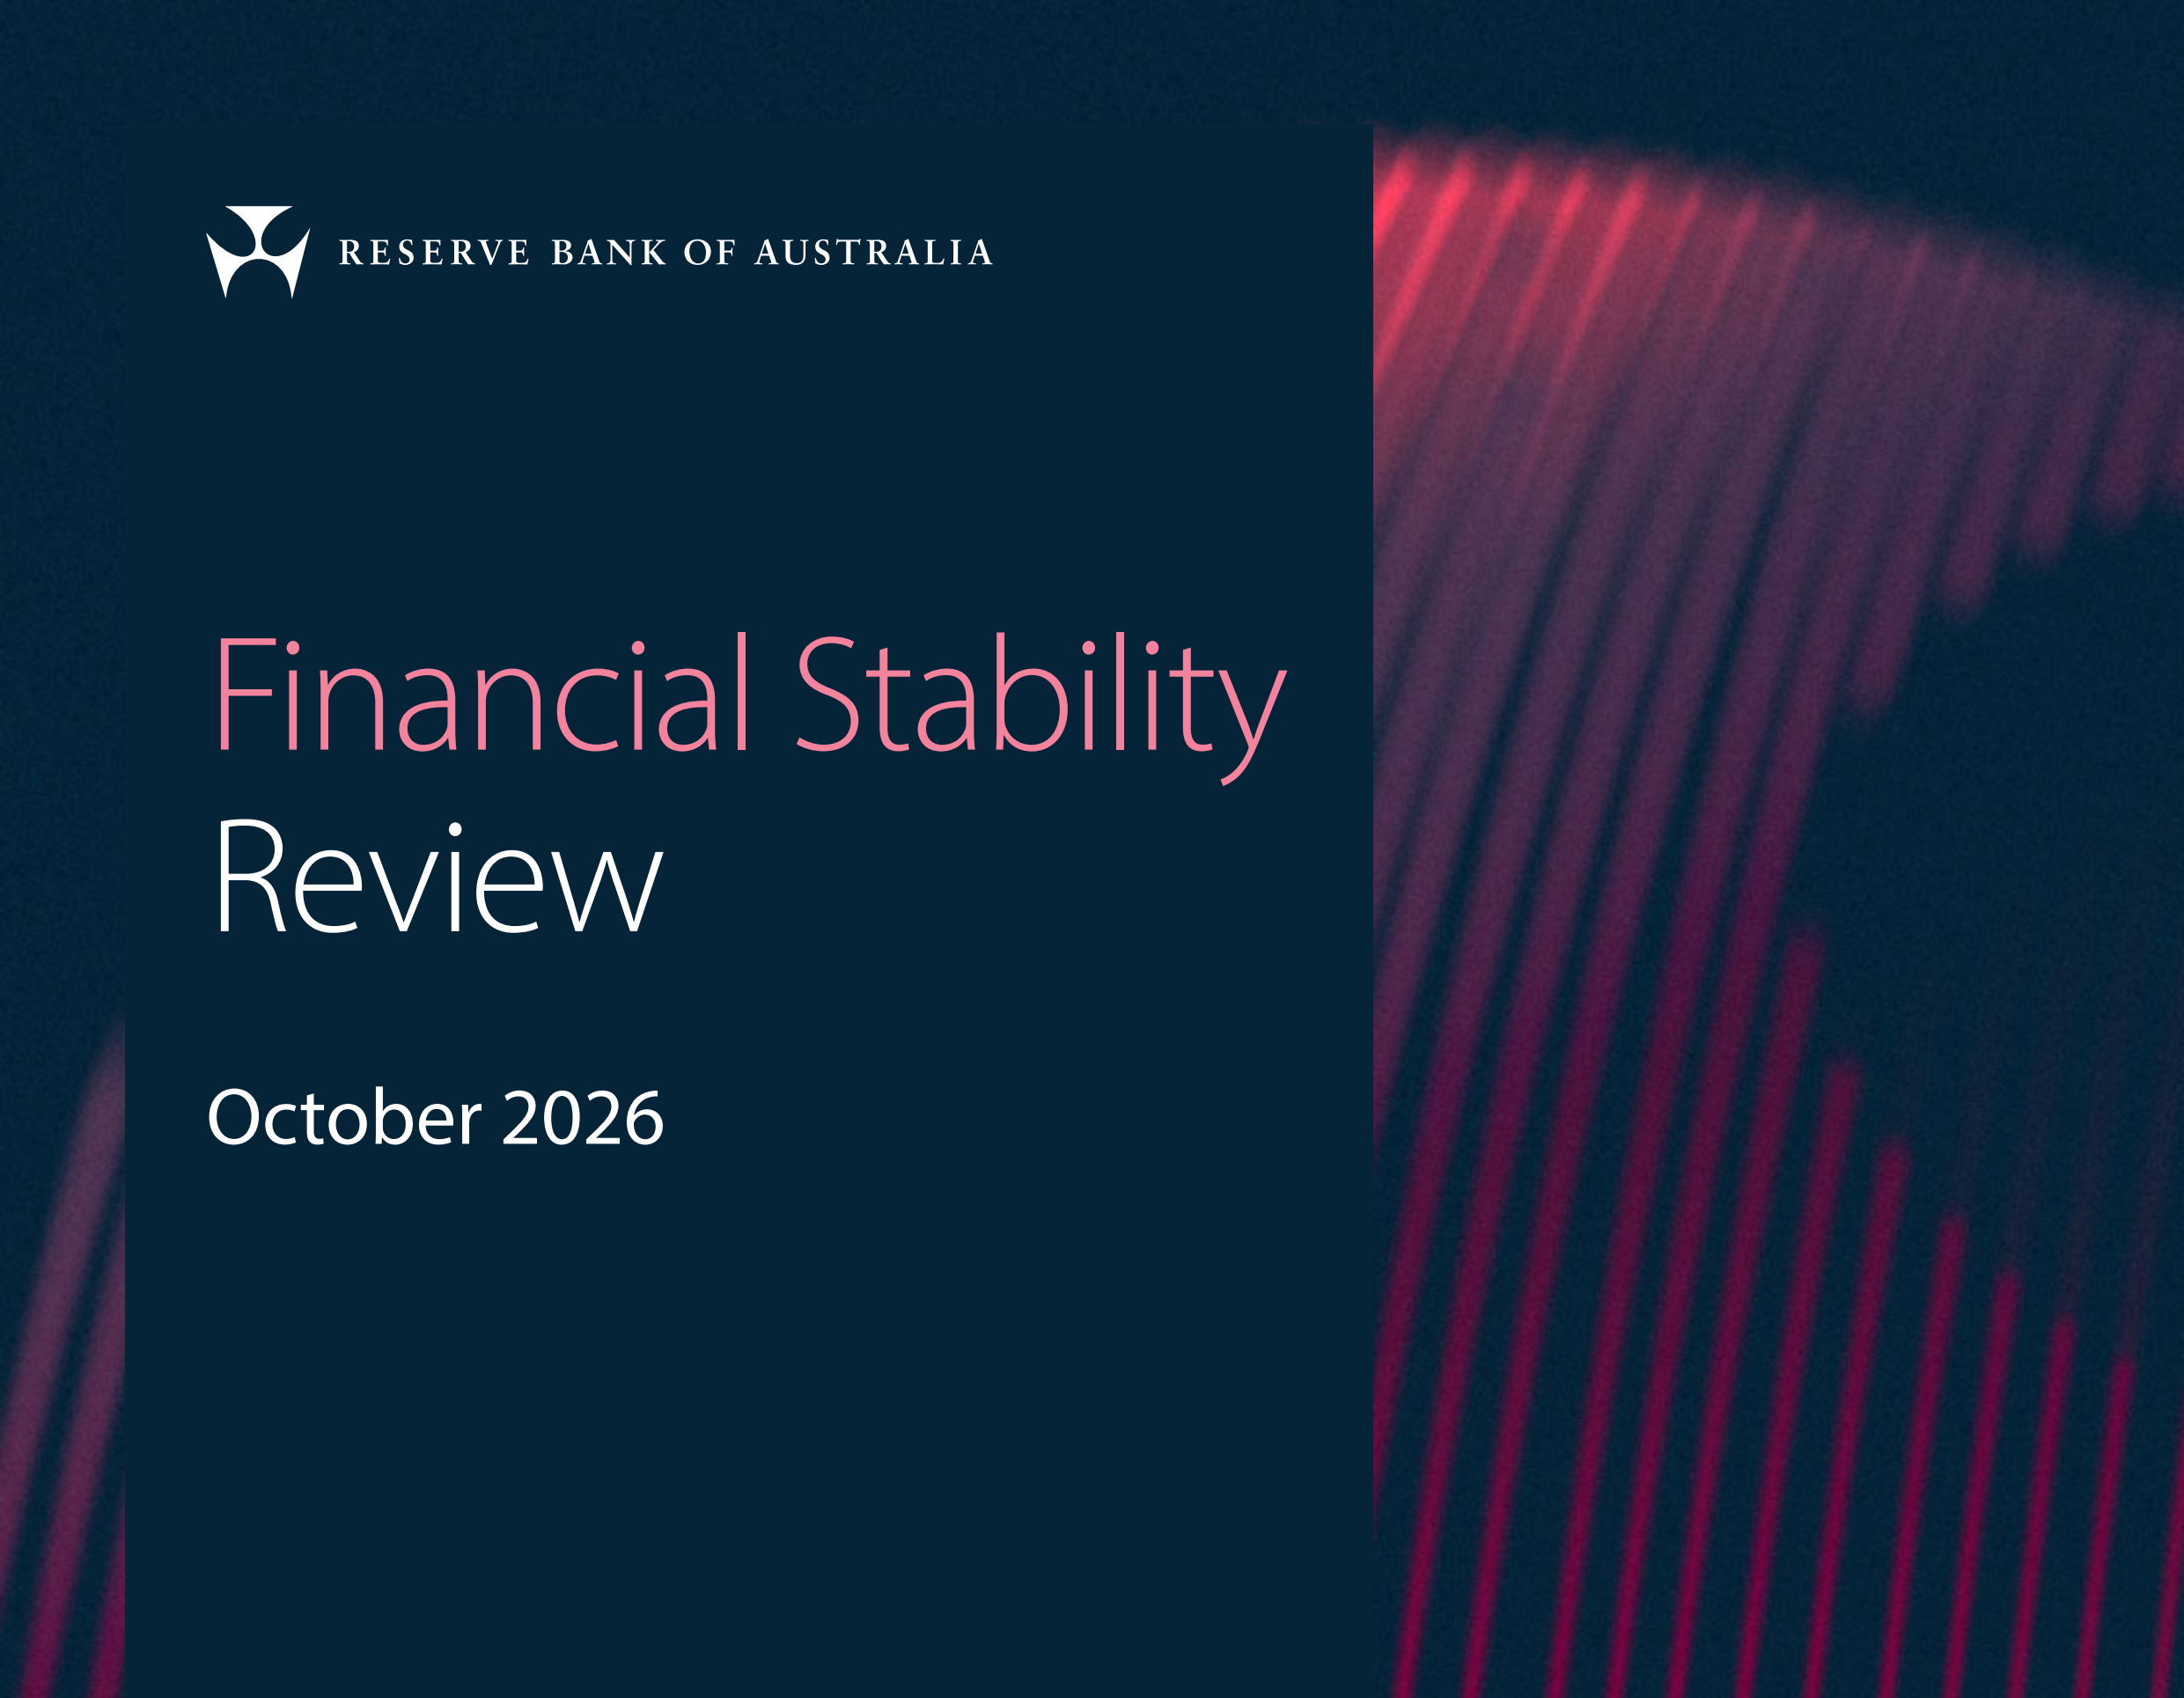
IN THE NEWS
'No Room for Complacency'
The RBA says Australia's financial system remains resilient, but risks are building from outside it.
Most households and businesses with loans are well placed to manage softer growth and lower housing prices.
Source: Reserve Bank of Australia, Financial Stability Review, October 2026 (released 1 October 2026).
Notes:
Sources:
S5 Reserve Bank of Australia, Financial Stability Review – October 2026, 2026-10-01: https://www.rba.gov.au/publications/fsr/2026/oct/

Slide 22
Questions to Ask Before You Act
Start with why you bought.
01 | Could I hold if rates rise again?
02 | How long would my buffers last?
03 | Is this still a long-term hold?
General information only. Consider obtaining advice from an appropriately qualified professional.

Slide 23
Five Things to Review This Week
Repayments
Could each loan stay manageable if rates rise again?
Buffers
How many months of holding costs could you cover today?
Loan structure
When did you last compare your rate and lender?
Rental income
Is each rent in line with the market?
Your plan
Does each property still fit your long-term plan?
General information only. Consider obtaining advice from an appropriately qualified professional.

Slide 24
Builders Are Seeing
Demand Soften
HIA new home sales, a leading indicator of dwelling demand, have declined materially.
Many builders report fewer enquiries and sales.
Dwelling investment was much stronger than expected in the first half of 2026, but leading indicators have started to soften.
Source: Reserve Bank of Australia, Statement on Monetary Policy, November 2026 (HIA and RBA liaison).
Notes:
These are demand indicators, not approvals, starts or completions. September approvals actually rose (see State of the Nation).

Slide 25
Investors Have Equity
on Their Side
Like other borrowers, most investors have considerable equity in their properties.
Compared with owner-occupiers, investors have historically had lower arrears and default rates.
Equity and buffers buy time. Use it to plan, not to panic.
Source: Reserve Bank of Australia, Financial Stability Review, October 2026.

Slide 26
Rates are rising.
The plan still matters most.
Know your numbers now, so a higher rate is a cost you planned for, not a shock.

