Slide 1
STATE OF THE NATION
What's happening in Australia and what it means
for property owners and investors
by George Markoski

Slide 2
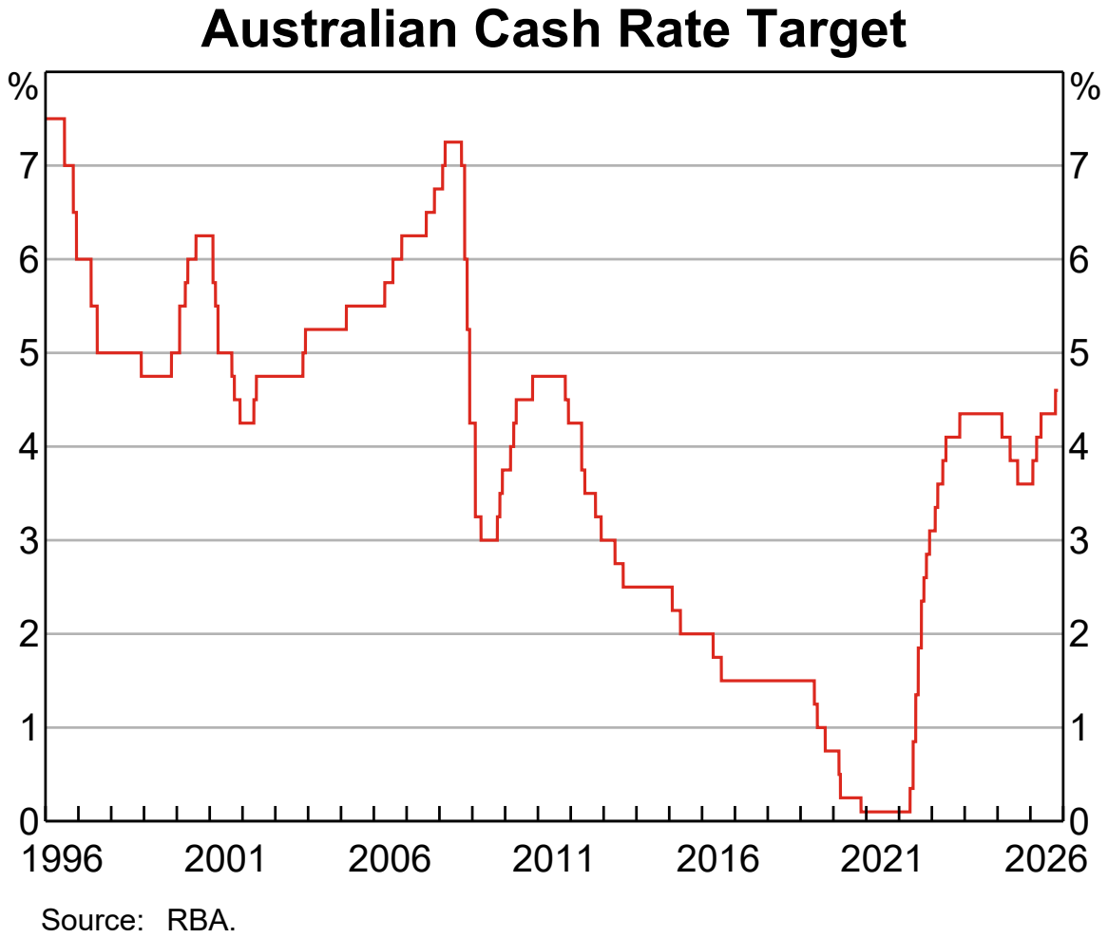
The RBA Has
Raised Rates
Again
The cash rate rose 25 basis points to 4.85% on 3 November.
Six board members voted to raise; three wanted to hold.
Source: Reserve Bank of Australia, Monetary Policy Decision, 3 November 2026; chart: RBA Chart Pack, 4 November 2026, data to 29 October (before this rise).
Notes:
Open with the decision itself, then hand to George: what a split board tells us about the next move. The chart shows the path up to the previous meeting; this week's rise is not on it yet.
Register: R01, R02, R03, R04
Sources:
S1 Reserve Bank of Australia, Statement by the Monetary Policy Board: Monetary Policy Decision, 2026-11-03: https://www.rba.gov.au/media-releases/2026/mr-26-30.html
S3 Reserve Bank of Australia, Chart Pack, November 2026, 2026-11-04: https://www.rba.gov.au/chart-pack/pdf/chart-pack.pdf

Slide 3
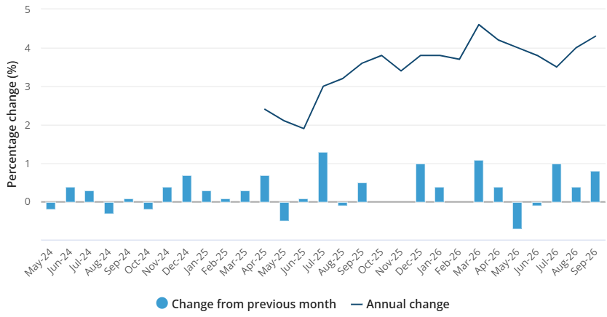
Inflation Is Moving the Wrong Way
4.3%
annual inflation to September, up from 4.0% in August
Source: Australian Bureau of Statistics, “All groups CPI, Australia, monthly and annual movement (%)”, Consumer Price Index, Australia, September 2026 (released 28 October 2026).
Notes:
Monthly CPI, original terms. Seasonally adjusted it was 4.4%.
Register: R05, R06, R12
Sources:
S2 Australian Bureau of Statistics, Consumer Price Index, Australia, September 2026, 2026-10-28: https://www.abs.gov.au/statistics/economy/price-indexes-and-inflation/consumer-price-index-australia/latest-release

Slide 4
Where Prices Are Rising Fastest
8.7%
5.2%
4.7%
transport, annual rise to September
housing costs, annual rise to September
education, annual rise to September
Each is rising faster than overall inflation of 4.3%.
Source: Australian Bureau of Statistics, Consumer Price Index, Australia, September 2026 (CPI groups, year to September 2026).
Notes:
Register: R07, R08, R09, R13
Sources:
S2 Australian Bureau of Statistics, Consumer Price Index, Australia, September 2026, 2026-10-28: https://www.abs.gov.au/statistics/economy/price-indexes-and-inflation/consumer-price-index-australia/latest-release

Slide 5
The RBA Doesn't Expect a Quick Fix
Inflation is forecast to stay elevated through much of 2027, reaching the top of the target range around three quarters later than previously forecast.
What should investors do if rates stay high?
Source: Reserve Bank of Australia, Monetary Policy Decision, 3 November 2026.
Notes:
Register: R10
Sources:
S1 Reserve Bank of Australia, Statement by the Monetary Policy Board: Monetary Policy Decision, 2026-11-03: https://www.rba.gov.au/media-releases/2026/mr-26-30.html

Slide 6
WHAT IT MEANS FOR INVESTORS
Cutting through the noise to find the signal

Slide 7
Three Things to Review This Week
Repayments
Could each loan stay manageable if rates rise again?
Buffers
How many months of holding costs could you cover today?
Loan structure
When did you last compare your rate and lender?
General information only. Consider obtaining advice from an appropriately qualified professional.

Slide 8
Rates are rising.
The plan still matters most.
Know your numbers now, so a higher rate is a cost you planned for, not a shock.

